Slide 1
SWAT-Kats
Muddy Roads
A Greenfoot Game
Amit Pandey - 011424231
Anudeep Rentala - 011417666
Navneet Jain - 011419291
Shafi Dayatar - 011445434
Swathi Koduri - 011440364

Slide 2


Slide 3
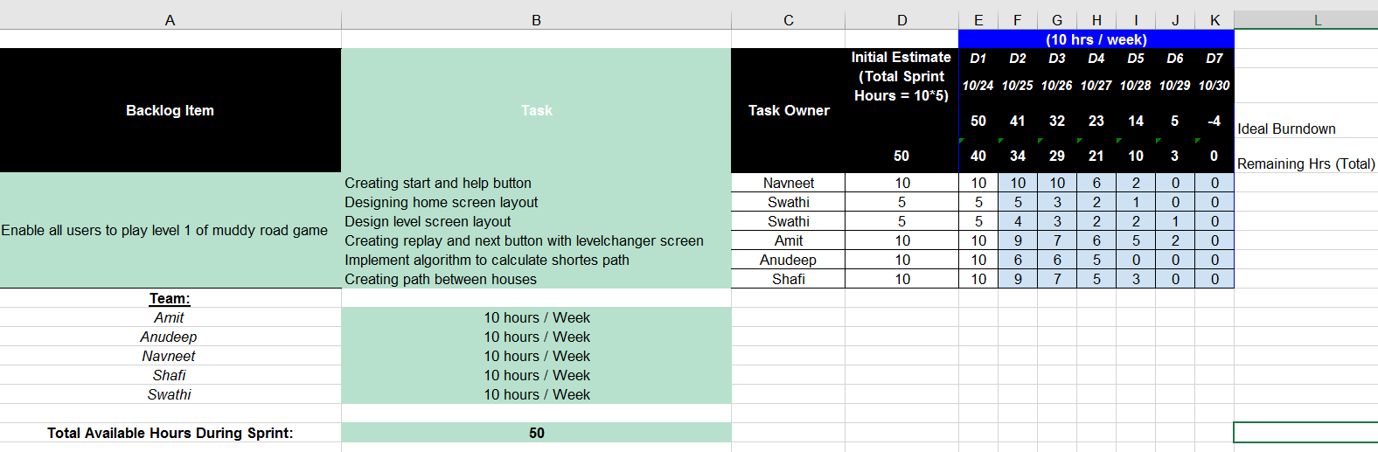
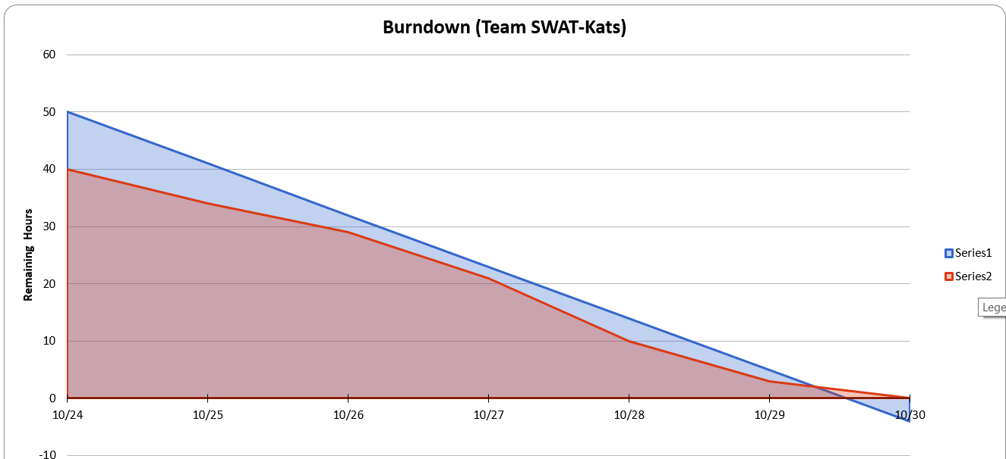
SWAT-Kats Sprint 1 Task Sheet and Burndown Chart

Slide 4
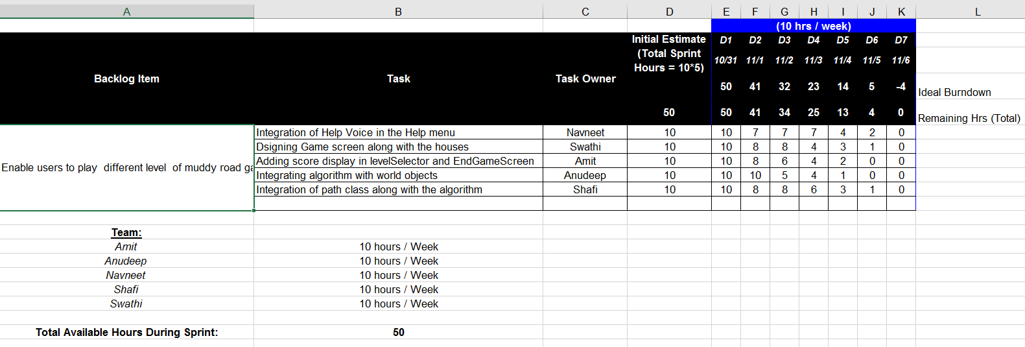
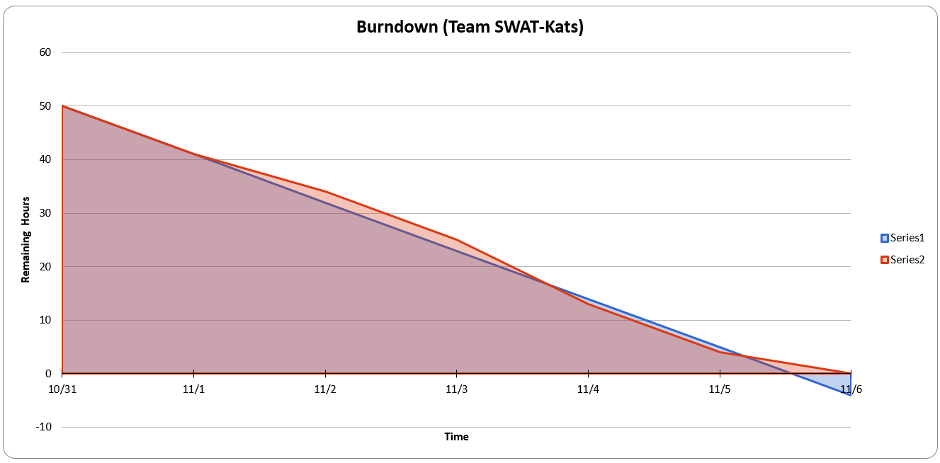
SWAT-Kats Sprint 2 Task Sheet and Burndown Chart

Slide 5
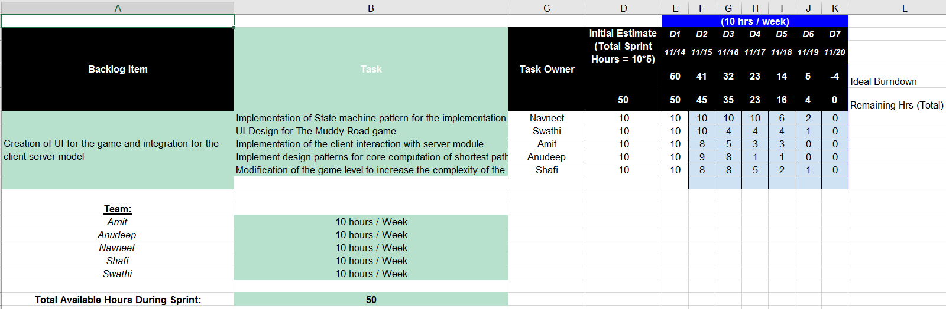
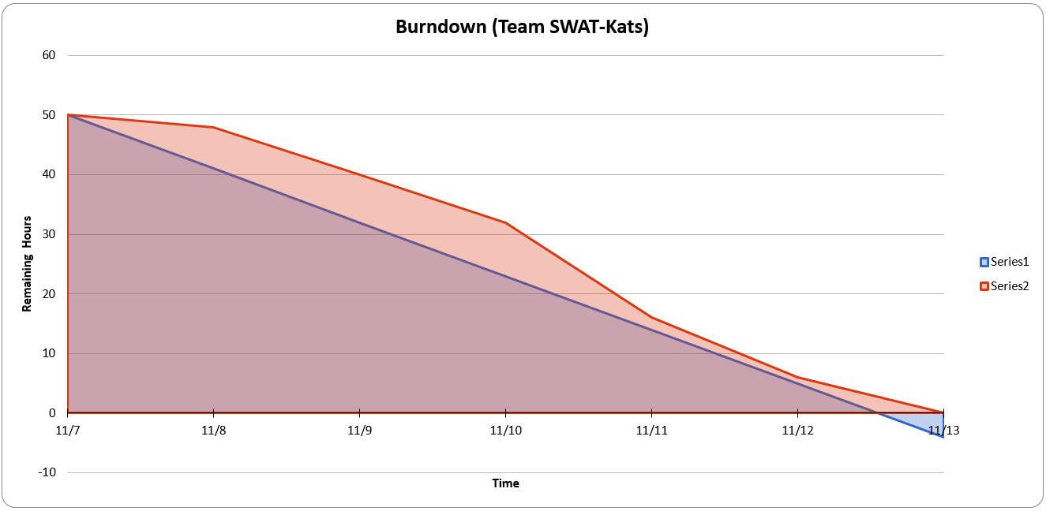
SWAT-Kats Sprint 3 Task Sheet and Burndown Chart

Slide 6

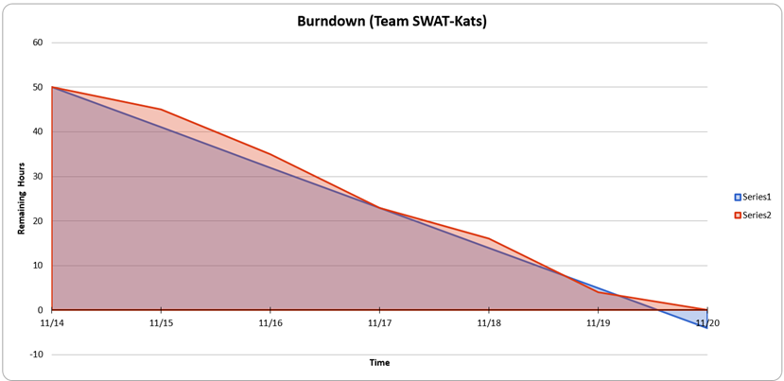
SWAT-Kats Sprint 4 Task Sheet and Burndown Chart

Slide 7
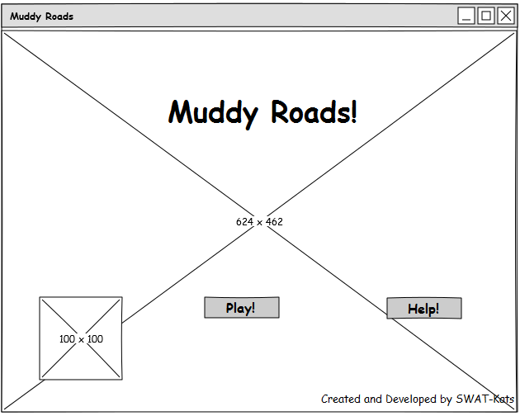
UI Wireframes
Start Screen

Slide 8
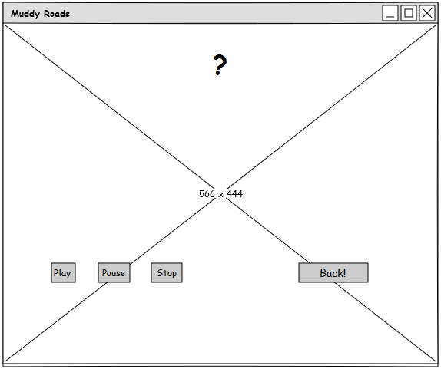
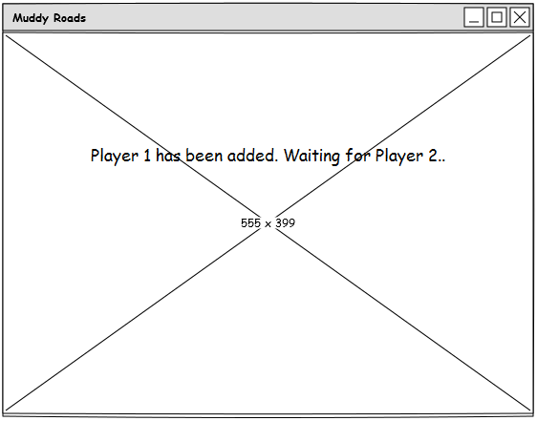
UI Wireframes
Help and Player Wait Screen

Slide 9
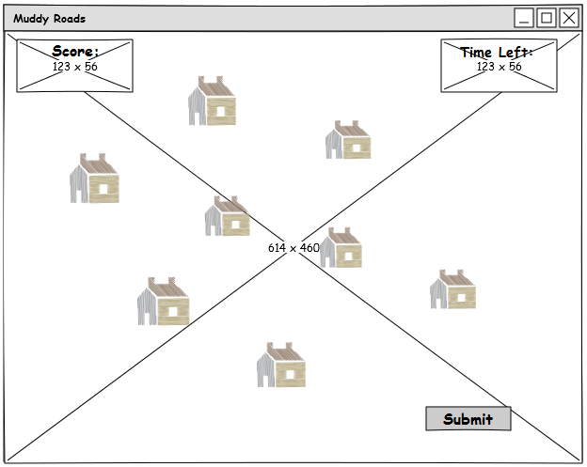
UI Wireframes
Level Screen

Slide 10
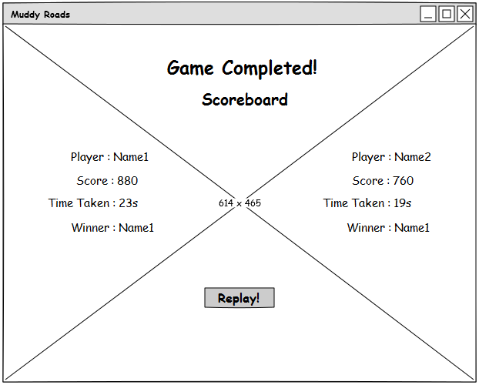
UI Wireframes
Game Complete Screen

Slide 11
Design Patterns
Let’s take a look at the Design Patterns implemented in the game.

Slide 12
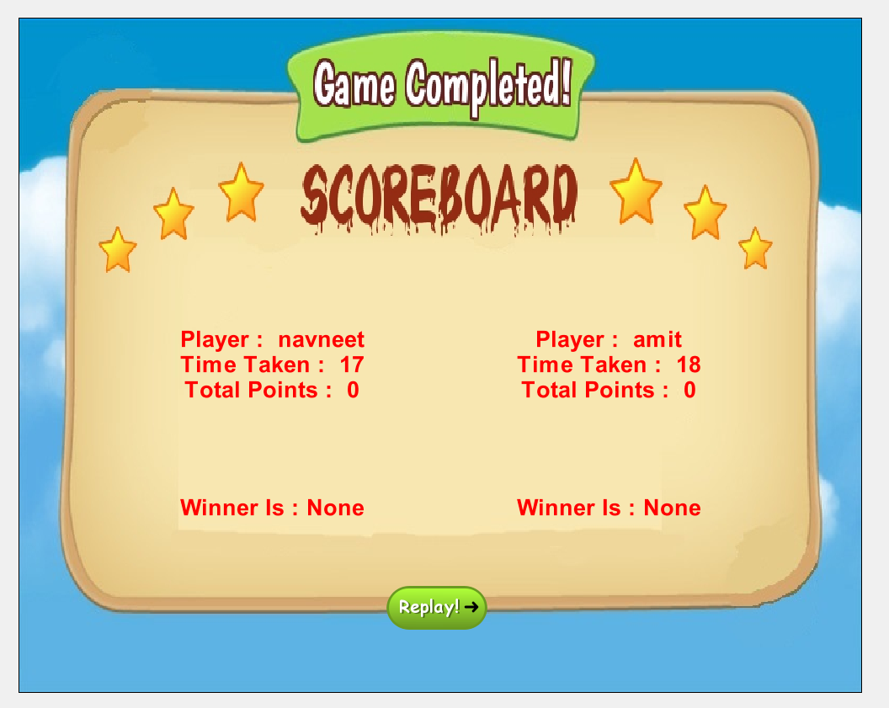
Observer Pattern

Slide 13
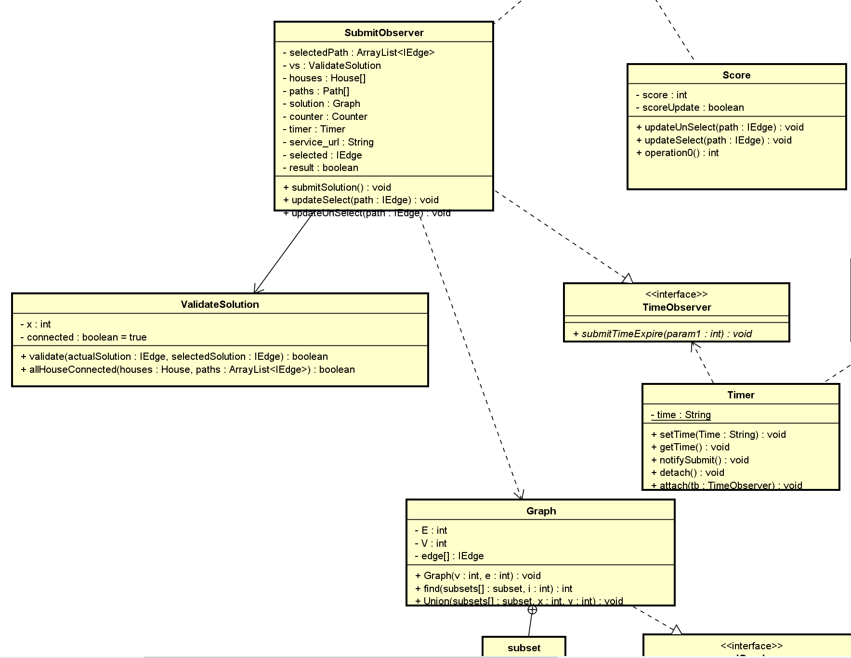
Observer Pattern

Slide 14
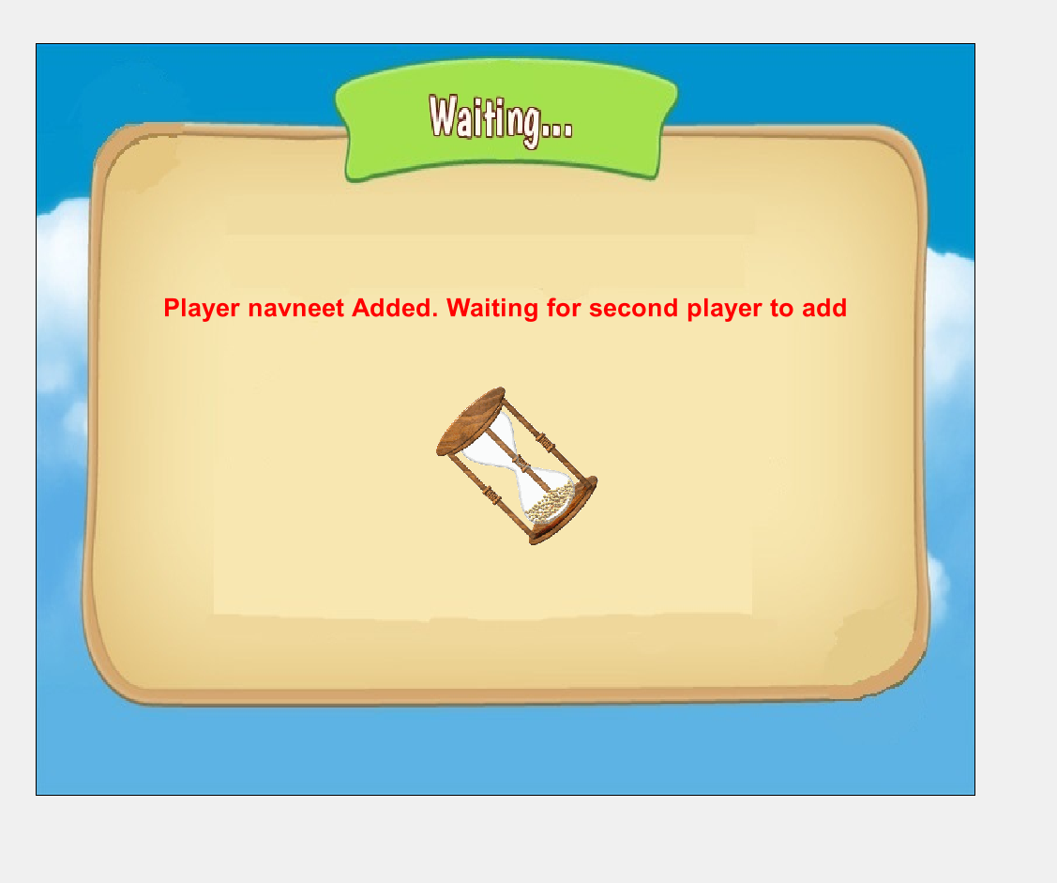
State Pattern

Slide 15
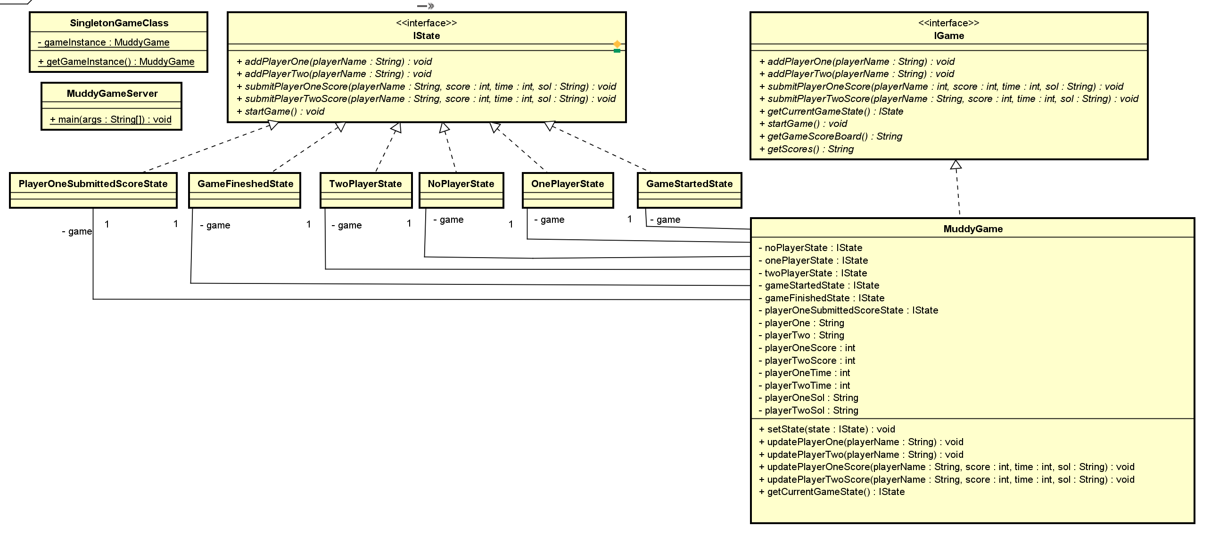
State Pattern

Slide 16
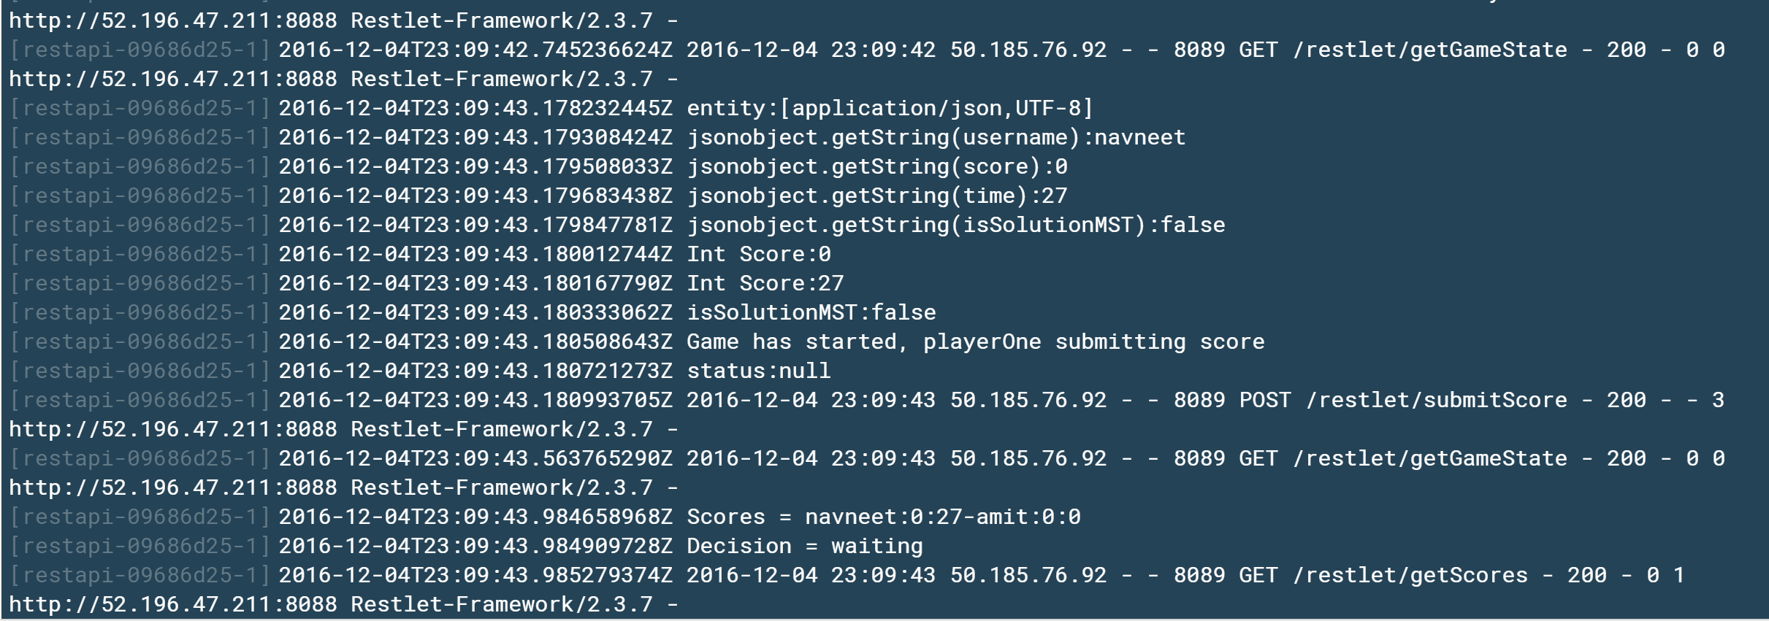
Proxy Pattern

Slide 17
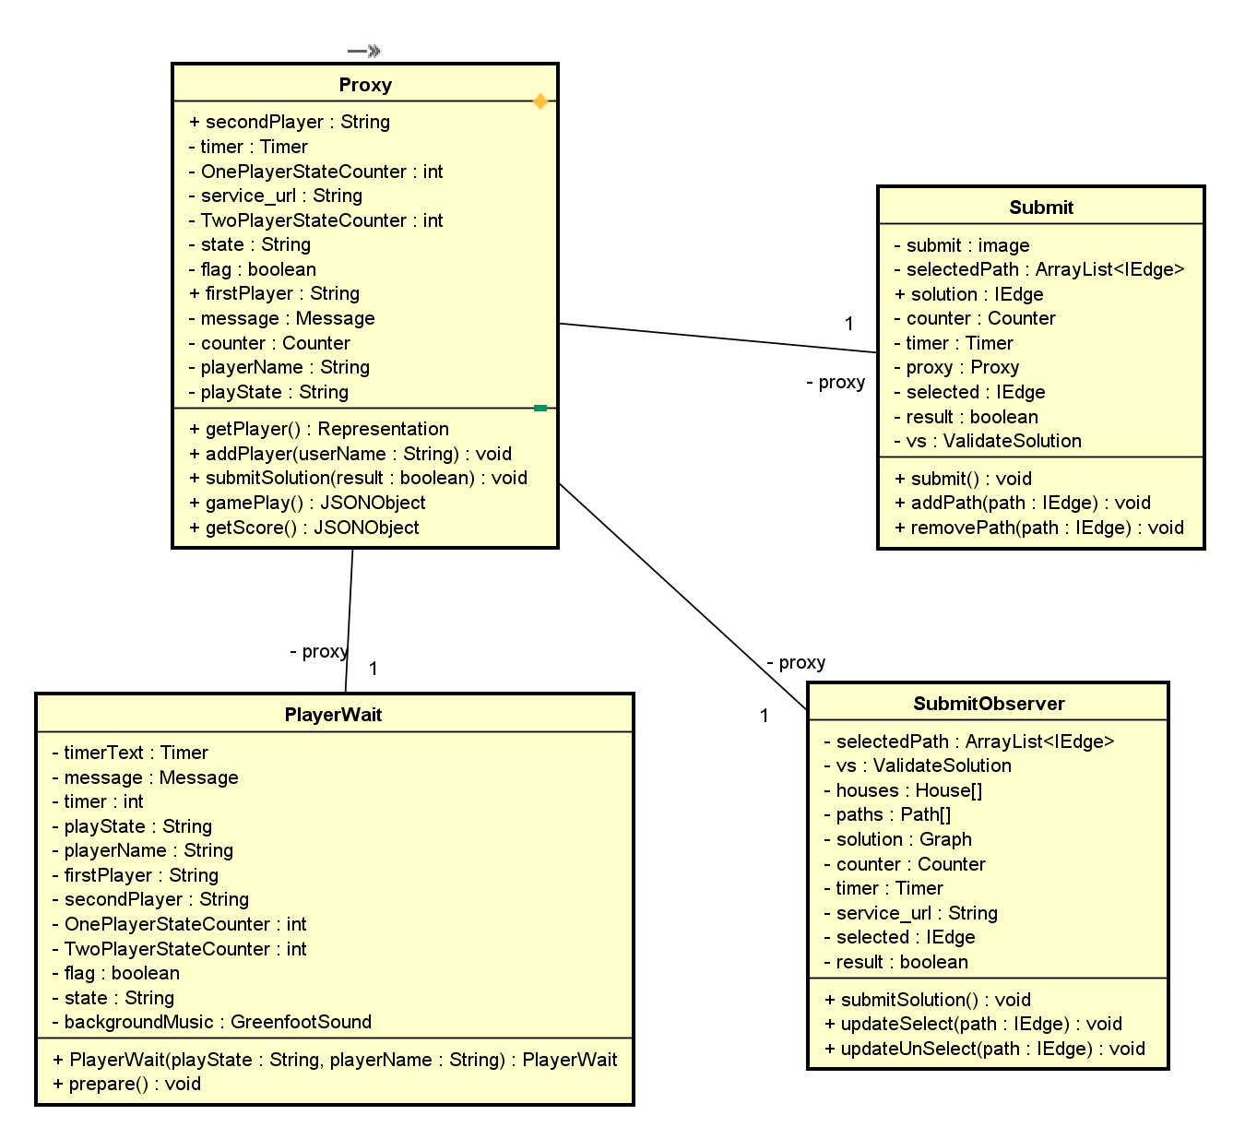
Proxy Pattern

Slide 18
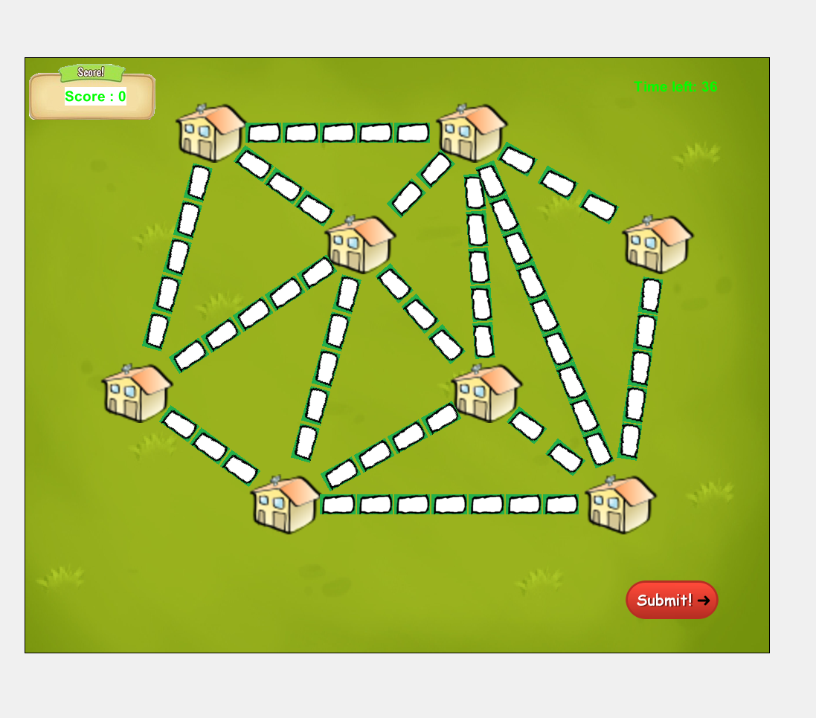
Composite Pattern

Slide 19
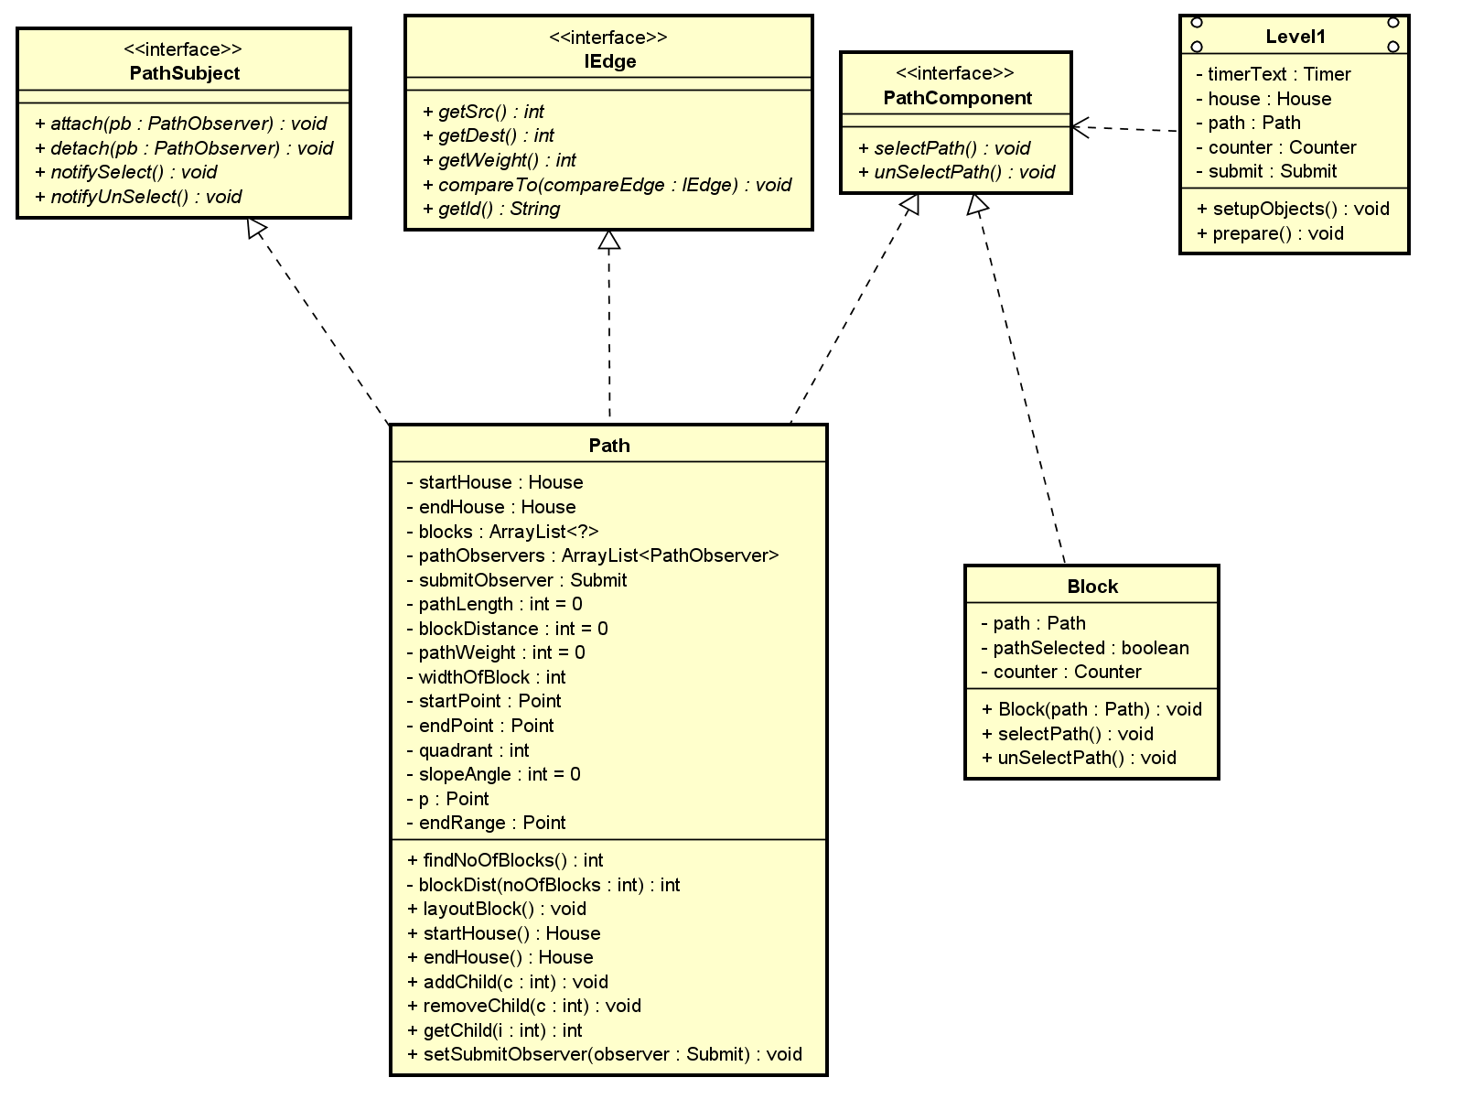
Composite Pattern

Slide 20
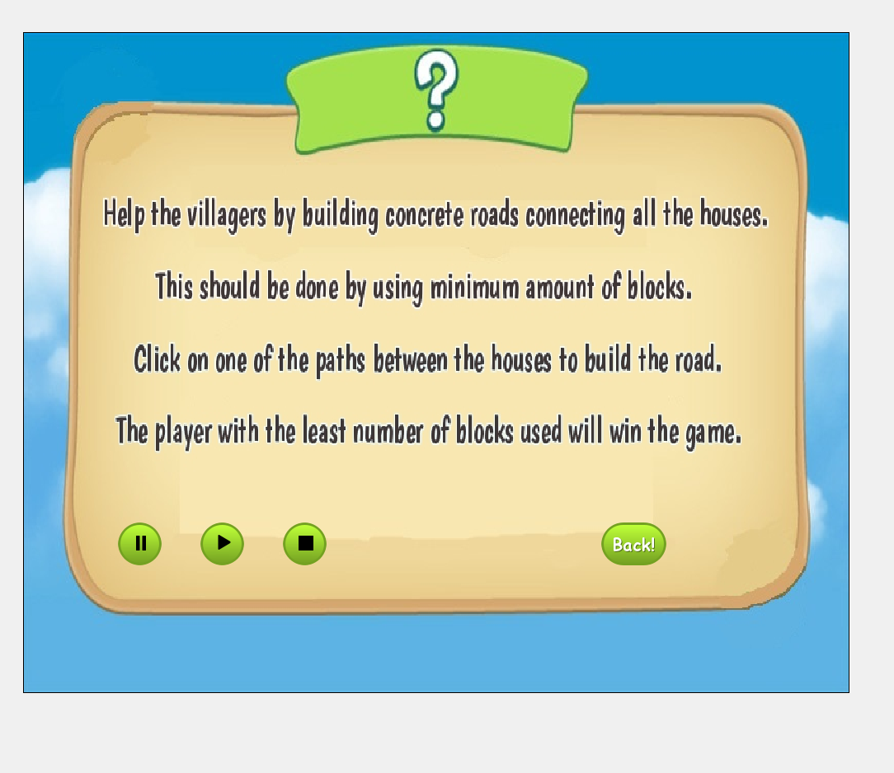
Chain of Responsibility Pattern

Slide 21
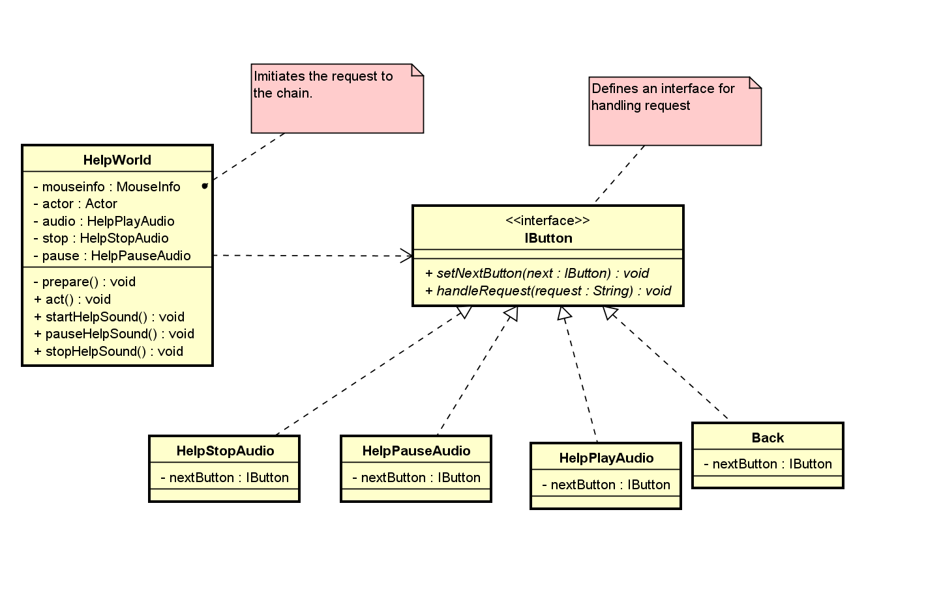
Chain of Responsibility Pattern

Slide 22
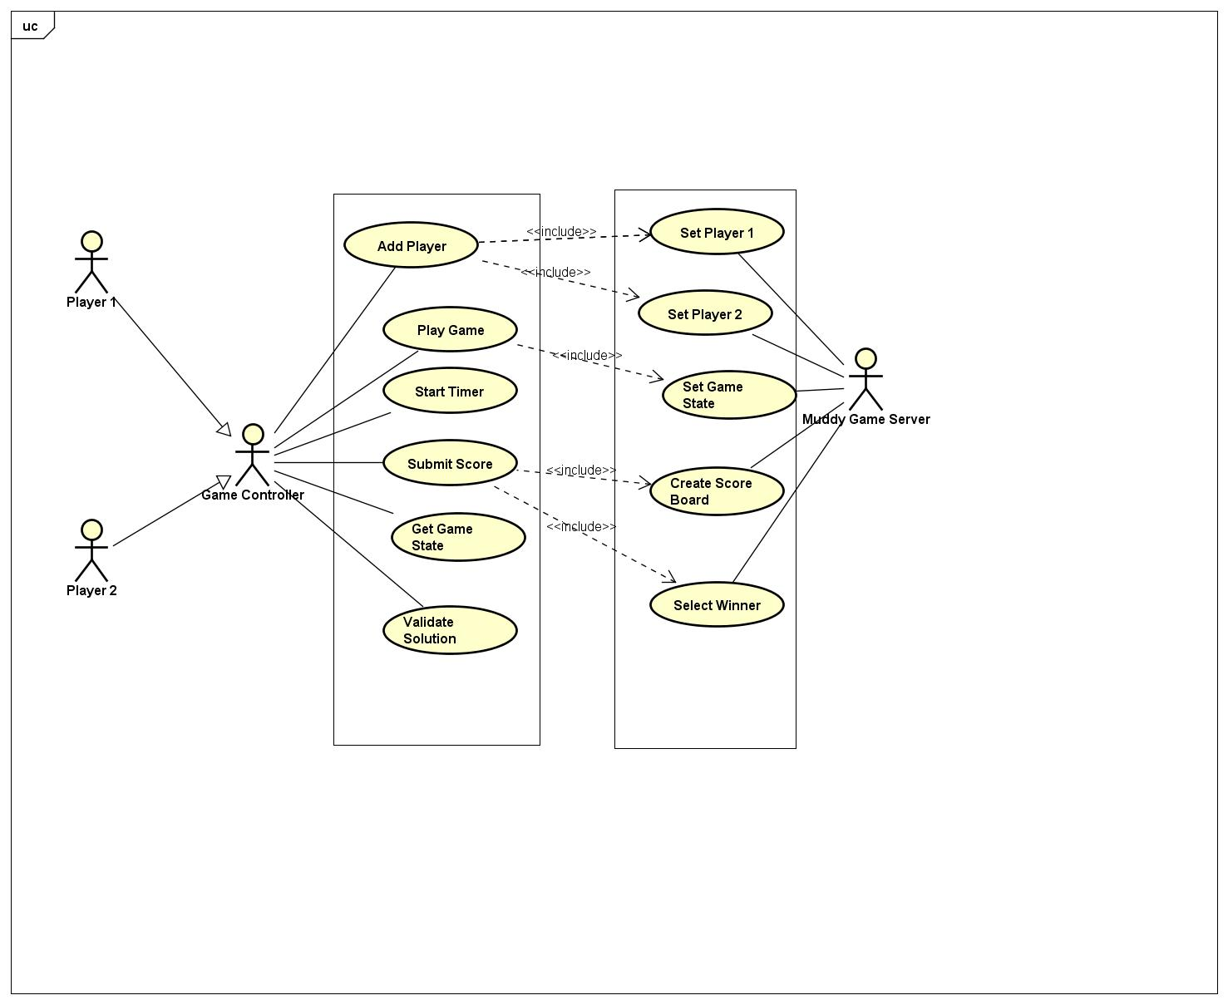
Use Case Diagram

Slide 23
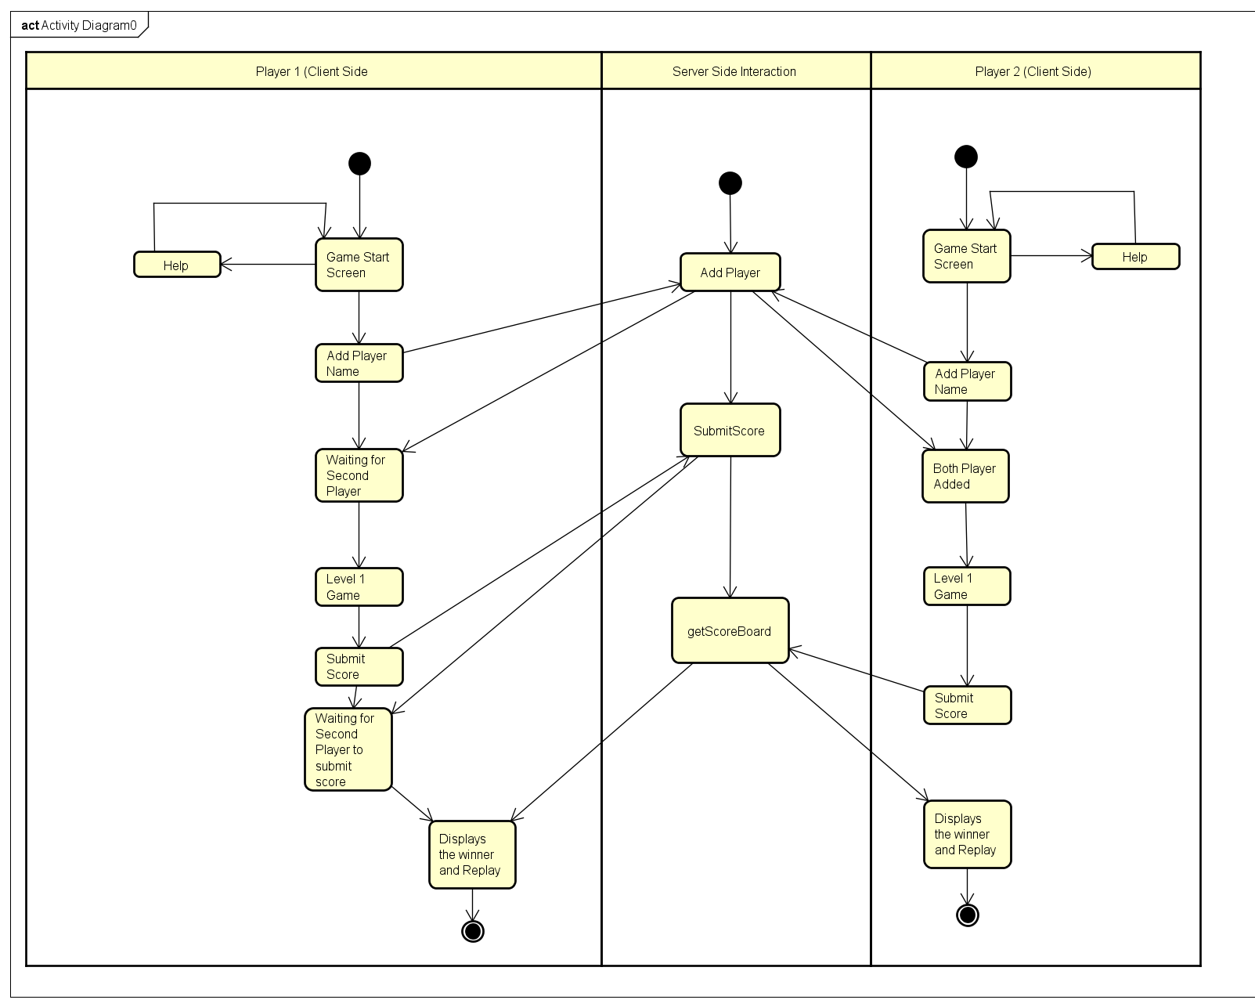
Activity Diagram

Slide 24
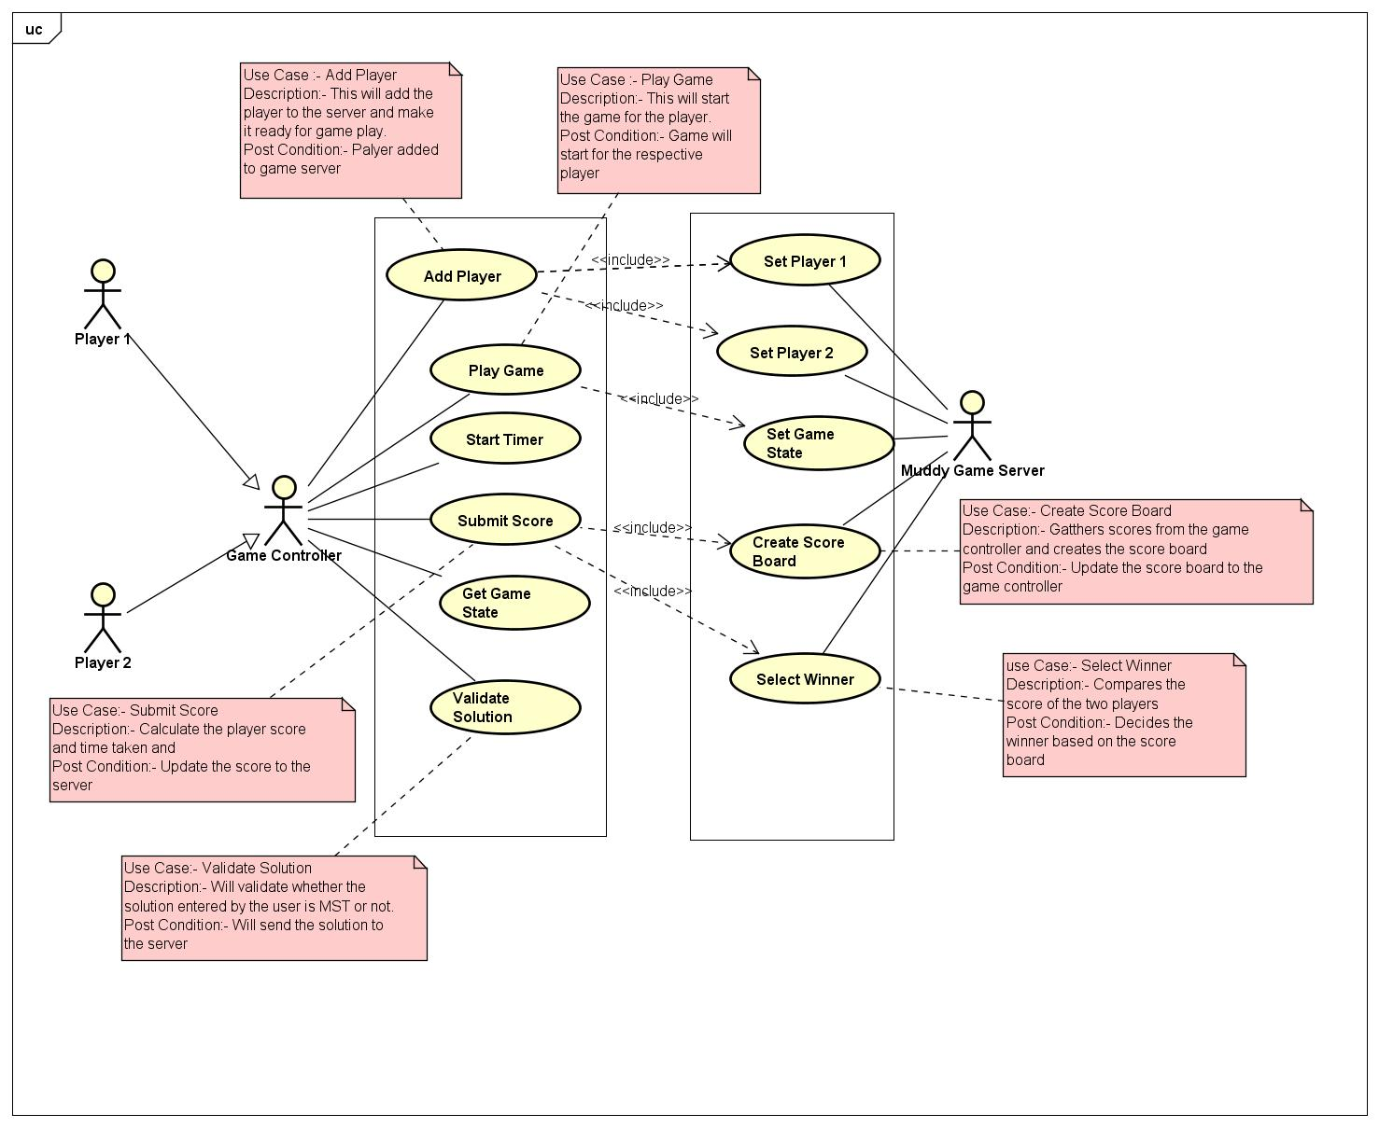
Use Case Specification

Slide 25
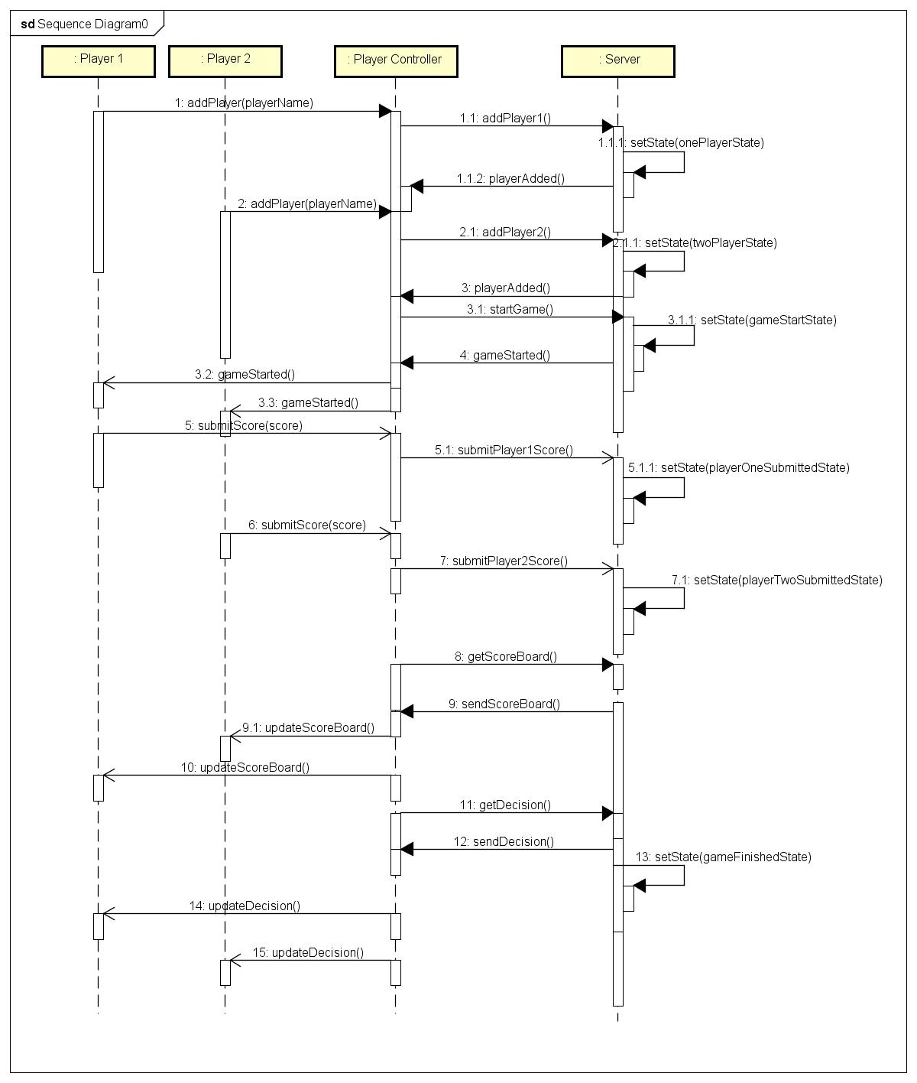
Sequence Diagram

Slide 26
THANKS!
Any questions?

